Slide 1

Long Range Planning Committee: Diversity Survey
Nicholas A. Gage, Ph.D.
Associate Professor
School of Special Education, School Psychology, & Early Childhood Studies

Slide 2

Conducted a BRIEF Survey
Goal: Collect data on faculty diversity to begin setting long-term goals and targets for recruitment and retention of diverse faculty
Method: Open response survey of a few diversity indicators
Note: Many faculty suggested, rightly, that diversity also includes sexual orientation. The committee 100% agrees, but was not comfortable asking this given that it is possible to identify faculty and current sunshine laws.

Slide 3
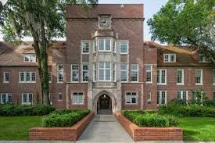
Results
Forty-six complete faculty responses (n = 46)
  Seventeen HDOES (n = 17)
  Fifteen SESPECS (n = 15)
  Fourteen STL (n = 14)

Slide 4
Gender

Slide 5
Race

Slide 6
Nationality

Slide 7
Disability

